Slide 1
Chapter 3 Digital Circuit
3.1 CMOS Transistor
3.2 CMOS Gate
3.3 Electrical Characteristics

Slide 2
3.1 CMOS Transistor
5.0V
1 (High-state)
0 (Low-state)
3.5V
1.5V
0.0V
Logic Level of 5V

Slide 3
NMOS Transistor
drain
gate
+
Gate = “0”
NMOS transistor is OFF.
Gate = “1” (high-state)
NMOS transistor is ON.
V_{gs}
source

Slide 4
PMOS Transistor
V_{gs}
source
+
gate
Gate = “1”
PMOS transistor is OFF.
Gate = “0” (low-state)
PMOS transistor is ON.
drain

Slide 5
3.2 CMOS Gate
CMOS Inverter
COMS NAND Gate
COMS NOR Gate
CMOS AND-OR-Inverter
CMOS Buffer
Three-State Buffer
Transmission Gate
Schmitt-Trigger Inverter
Open-Drain Output Circuit
Wired Logic

Slide 6
CMOS Inverter
V_{DD} = +5.0V
1. V_{IN} = 0.0V
Tn is OFF
Tp is ON
V_{OUT} ≈ V_{DD} = 5.0V
2. V_{IN} = V_{DD} = 5.0V
Tn is ON
Tp is OFF
V_{OUT} ≈ 0V
pmos
S
Tp
D
V_{OUT}
G
V_{IN}
Tn
S
nmos
V_{OUT} = V_{IN}

Slide 7
CMOS Inverter
V_{DD}
V_{DD} = +5.0V
Tp
Z
V_{out}
A
V_{in}
Tn
V_{in} | V_{out}
Low | High
High | Low

Slide 8
CMOS NAND Gate
V_{DD} = +5.0V
1. A or B is low-state
T1 or T3 is OFF
T2 or T4 is ON
Z ≈ V_{DD}
2. A and B are high-state
T1 and T3 are ON
T2 and T4 are OFF
Z ≈ 0V
T2
T4
Z
A
T1
B
T3
Z = A·B

Slide 9
CMOS NOR Gate
V_{DD} = +5.0V
1. A and B are low-state
T1 and T3 are OFF
T2 and T4 are ON
Z ≈ V_{DD}
2. A or B is high-state
T1 or T3 is ON
T2 or T4 is OFF
Z ≈ 0V
A
T2
B
T4
Z
T1
T3
Z = A+B

Slide 10
CMOS AND-OR-Inverter
V_{DD} = +5.0V
(1) Q1 and Q3 are ON,
or
(2) Q5 and Q7 are ON,
Z is 0V.
Otherwise, Z is high-state.
A
Q2
Q4
B
Q6
Q8
Z
Z = A·B + C·D
C
Q5
Q3
A
B
C
D
D
Q1
z
Q7

Slide 11
CMOS Buffer
V_{DD} = +5.0V
Z
A

Slide 12
Three-state Buffer
V_{CC}
EN=0,
C=1, Tp is OFF
B=1, D=0, Tn is OFF
OUT is floating state
high-impedance disconnected state
EN=1,
C=A , B=0 , D=A
OUT=A
OUT is low-state or high-state
EN
C
Tp
OUT
A
D
Tn
B
EN
A
OUT

Slide 13
Transmission Gate
EN = 0，EN_L = 1，
Gate is OFF，
A and B are disconnected
EN = 1，EN_L = 0，
Gate is ON，
bidirectional transmission
A=B
EN_L
A
B
EN

Slide 14
Schmitt-Trigger Inverter
V_{OUT}
V_{T-}
V_{T+}
5.0
V_{T+}
2.9V
input
threshold
V_{T-}
2.1V
V_{IN}
2.1
2.9
5.0
Hysteresis 2.9V-2.1V=0.8V
Input rises to 2.9V, output becomes low-state.
Input falls to 2.1V, output becomes high-state.

Slide 15
Open-Drain Output Circuit
’
V_{CC}
V_{CC}
Z
A
A
Z
B
B
NAND Gate
The drain terminal is not connected to the voltage directly.

Slide 16
Wired Logic
V_{CC}
V_{CC}
Wired
logic
A
V_{CC}
R
Z1
B
Z
Z2
C
Z = Z1 · Z2
= A·B · C·D
= A·B · C·D
= A·B + C·D
D

Slide 17
Unused inputs of CMOS circuit
X
Z
+5V
X
Z
1kΩ
Z
X

Slide 18
3.3 Electrical Characteristics
(1) Logic Level
(2) Fanin
(3) Fanout
(4) Direct Current Noise Margin
(5) Transition Time
(6) Propagation Delay
(7) Diode
(8) Bipolar junction transistor

Slide 19
Logic Level
V_{OHmin}:Vcc-0.1V
V_{CC}
High State
Low State
V_{IHmin}:
70%V_{CC}
V_{ILmax}:
30%V_{CC}
V_{OLmax}:Ground+0.1V
0

Slide 20
Fanin
For a logic gate, the number of inputs allowed is named as “fanin”.
NOR gate ≤4
NAND gate ≤6

Slide 21
Fanout
“Fanout” is the number of gates that a logic gate can drive.

Slide 22
Fanout
74HCT drives 74LS
CMOS: 74HCT
I_{OH} = 4 mA
I_{OL} = 4 mA
I_{IH} = 1 μA
I_{IL} = 1 μA
TTL: 74LS
I_{OH} = 0.4mA
I_{OL} = 8 mA
I_{IH} = 0.02mA
I_{IL} = 0.4 mA
Low-state fanout：
High-state fanout：
Overall fanout：min(200,10)=10

Slide 23
Fanout
74HCT drives 74LS
CMOS: 74HCT
I_{OH} = 4 mA
I_{OL} = 4 mA
I_{IH} = 1 μA
I_{IL} = 1 μA
TTL: 74LS
I_{OH} = 0.4mA
I_{OL} = 8 mA
I_{IH} = 0.02mA
I_{IL} = 0.4 mA
Residual driving capacity：

Slide 24
Direct Current Noise Margin
When two logic gates are cascaded, we use the “direct current noise margin” to measure the noise voltage gap between the driving gate and the driven gate.
If the DC noise margin is positive, the voltage level of both the driving gate and the driven gate are compatible.
Otherwise, the voltage level of the driving gate is destroyed and unrecognizable for the driven gate.

Slide 25
Direct Current Noise Margin
CMOS
TTL
V_{OHmin}
3.84
V_{OHmin}
2.7
V_{IHmin}
2.0
V_{IHmin}
2.0
V_{ILmax}
0.8
V_{ILmax}
0.8
V_{OLmax}
0.33
V_{OLmax}
0.5
Low state: V_{ILmax}-V_{OLmax}
High state: V_{OHmin}-V_{IHmin}

Slide 26
74HCT
74LS
V_{OHmin}
3.84
V_{OHmin}
2.7
V_{IHmin}
2.0
V_{IHmin}
2.0
V_{ILmax}
0.8
V_{ILmax}
0.8
V_{OLmax}
0.33
V_{OLmax}
0.5
74HCT drives 74LS
High state: 3.84 – 2.0 = 1.84V
Low state: 0.8 – 0.33 = 0.47V
74LS drives 74HCT
High state: 2.7 – 2.0 = 0.7V
Low state: 0.8 – 0.5 = 0.3V
Therefore, they are compatible.

Slide 27
Transition Time
In the digital circuit, the time required for the circuit output to change between the low-state and high-state voltage is named as the “transition time”.
10%
10%
rise time t_{r}
Fall time t_{f}
circuit output from low-state to high-state
circuit output from high-state to low-state

Slide 28
Propagation Delay
When the voltage level of the circuit input changes, and the voltage level of the circuit output changes correspondingly, the total time required is named as the “propagation delay”.
V_{IN}
V_{OUT}
The input changes to be high, and the output changes to be low
The input changes to be low, and the output changes to be high

Slide 29
Diode
＋
Anode
Cathode
R_{f}
V_{d}
forward-biased
+
voltage level of anode is higher than that of cathode
reverse-biased
+
voltage level of anode is lower than that of cathode

Slide 30
Diode
V_{CC} 5V
D₁
R
A
Y
B
D₂
Input (5V, 5V), output ≈ 5V
Input (0V, 5V), output = 0.6V
diode-drop 0.6V

Slide 31
Bipolar junction transistor
V_{CC}
collector
R_{C}
base
+
R_{B}
i_{C}
+
v_{o}
v_{i}
-
-
emitter
NPN Transistor
NPN Transistor Inverter
if the voltage level of “base” is high, the NPN transistor is conductive.
Otherwise, the NPN transistor is not conductive.

Slide 32
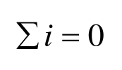
3.4 Calculation of current, voltage, and resistance
（1） Calculation of current
Kirchhoff’s Current Law（KCL）：Total current entering a junction is equal to total current leaving it.
Notes:
Ampere /ˈæmpeə/
Ohm /oʊm/
Volt /voʊlt/
Kirchhoff /ˈkɜrkhɔf/

Slide 33
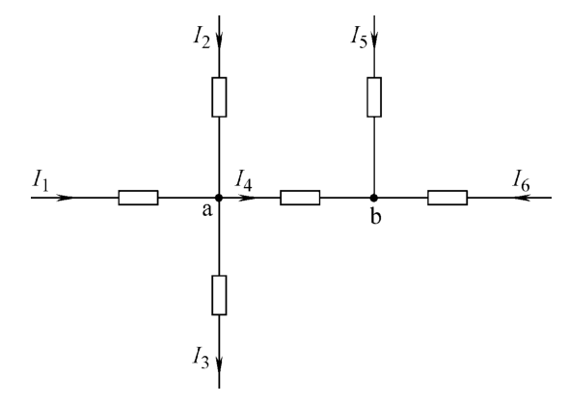




Example：I₁=-2A，I₂=6A，I₃=3A，I₅=-3A.
What are the currents I₄ and I₆ ?
Solution：

Slide 34

（2） Calculation of voltage
Kirchhoff's Voltage Law（KVL）：Algebraic sum of voltages around a loop equals to zero.

Slide 35
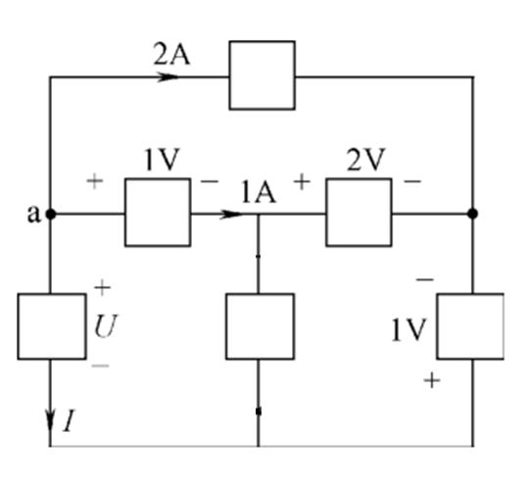




Example：What are the current I and the voltage U ?
Solution：
Based on point a

Slide 36
（3） Calculation of potential
Potential：U_{ab}=V_{a}-V_{b}
Voltage is the difference of potentials.

Slide 37
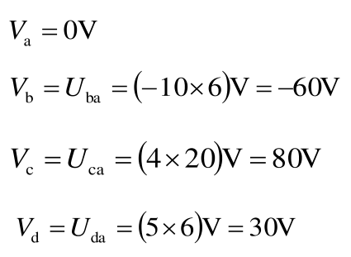
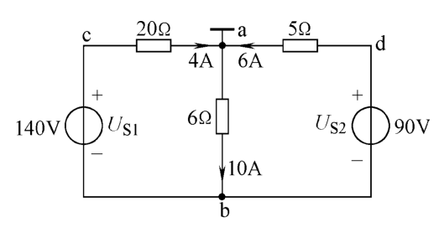
Example：Based on a and b, what are the potentials of a, b, c, d ?
Solution：
Based on point a

Slide 38
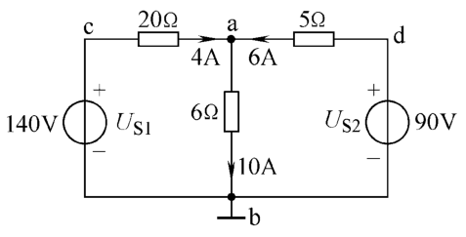
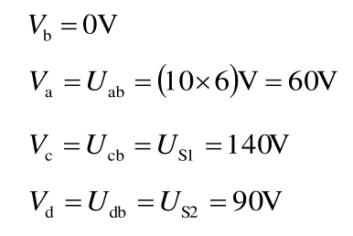
Based on point b：

Slide 39
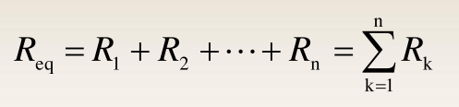
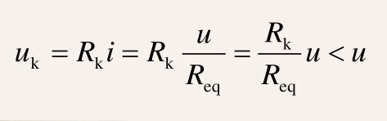
（4）Calculation of resistance
Resistors in series
Equivalent resistance：
Shared voltage：

Slide 40
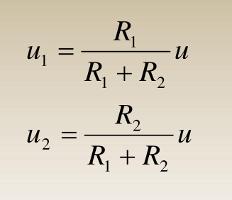
Shared voltages of two resistors：

Slide 41
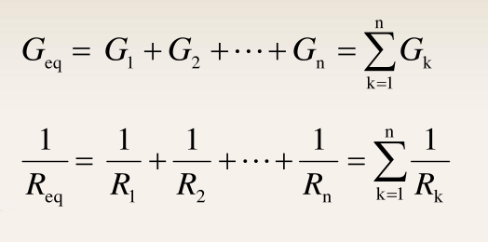
Parallel resistors
Conductance（Reciprocal of resistance）：

Slide 42
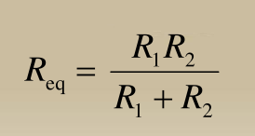
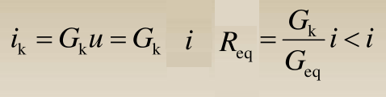
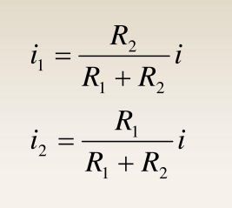
Equivalent resistance of two resistors in parallel：
Shared current：
Shared currents of two resistors in series：

Slide 43
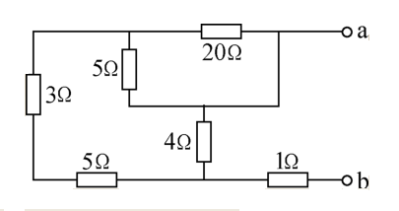
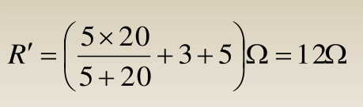
Example：What is the equivalent resistance R_{ab} ?
Solution：5Ω and 20Ω are in parallel.
It is in series with 3Ω and 5Ω defined as R´.

Slide 44
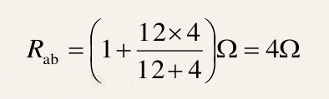
The 12Ω is in parallel with 4Ω.
It is in series with 1Ω.

Slide 45
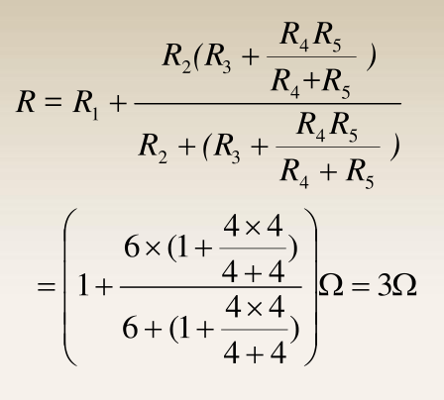
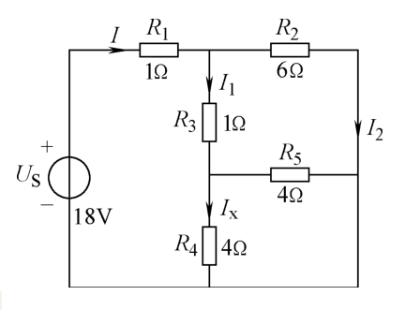
Example：What is the current I_{x} ?
Solution：

Slide 46
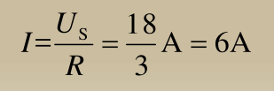
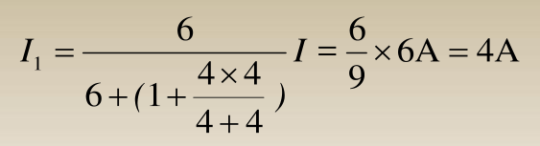
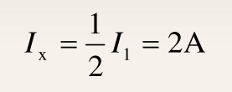
I₁ is shared with R₄ (I_{x}) and R₅ .
I is shared with I₁ and I₂ .

Slide 47
Superposition theorem
The strategy used in the superposition theorem is to eliminate all but one source of power within a network at a time. Then, we use series and parallel circuit analysis techniques to determine voltage drops and currents within the modified network for each power source separately.
This process is then repeated sequentially by individually evaluating the circuit for every voltage and current source in the system. After each individual analysis has been completed, the voltage and current values are all “superimposed” on top of each other (added algebraically) to find the actual voltage drops and currents with all sources active.

Slide 48
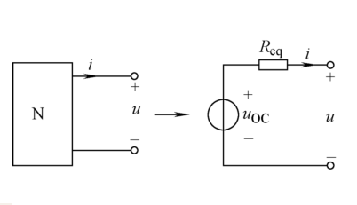
（5）Thevenin's theorem
The ideal model is in series, we calculate the open circuit voltage U_{oc}，and the equivalent resistance R_{eq} .
N：A resistor network that provides energy

Slide 49
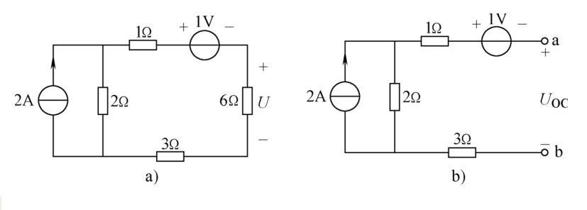

Example：Based on Thevenin's theorem，what is the voltage U of the 6Ω resistor ?
Solution：Disconnect 6Ω. Define the open circuit voltage U_{OC} .
Current source
Open circuit voltage：

Slide 50
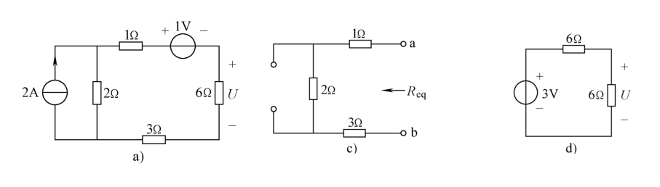
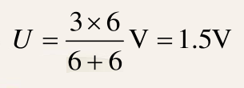

Voltage source (1V) is short circuited.
Current source (2A) is open circuited.
（d）Thevenin's Model
Equivalent resistance：
Voltage U of 6Ω：

Slide 51
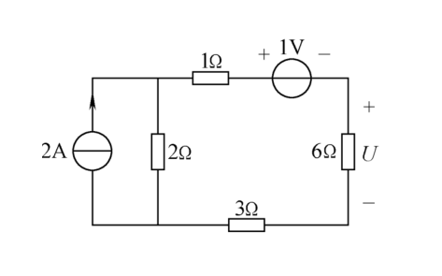
0.25V
2A
0.25A
1.75A
3.5V
1.5V
0.25A
2A
0.25A
0.75V

Slide 52
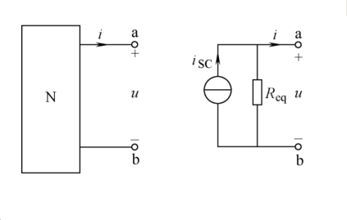
（6）Norton's theorem
The ideal model is in parallel, we calculate the short circuit current i_{sc}，and the equivalent resistance R_{eq} .

Slide 53
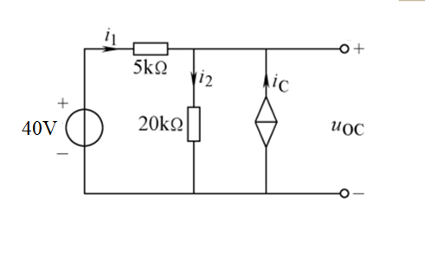



Example：Given i_{C}=0.75i₁, what are the Thevenin's model and Norton's model ?
Transistor
Controlled Current Source

Slide 54

Given
Open circuit voltage：

Slide 55
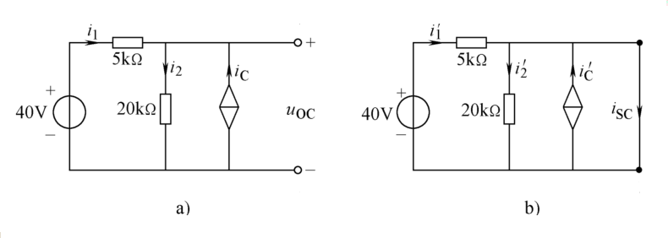
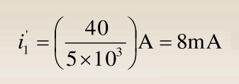

Given i_{C}=0.75i₁
Short circuit current：

Slide 56
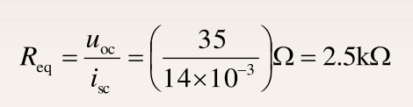
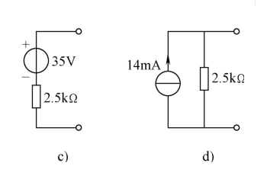
Equivalent resistance：
(c)Thevenin's model
(d)Norton's model

Slide 57
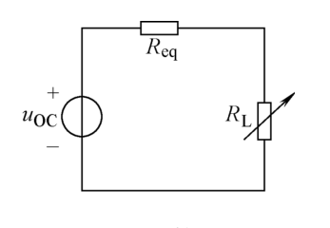
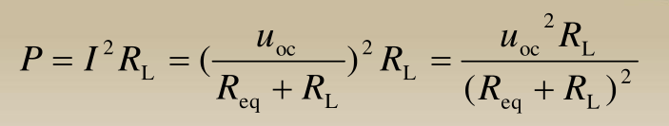
（7）Maximum power transfer theorem
How to obtain maximum power from a circuit for a resistance load ?
Load power：
R_{eq} and R_{L} share the voltage.

Slide 58
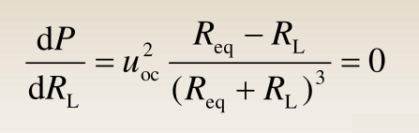
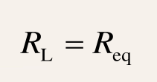
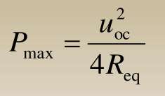
To get the maximum power P，derivation of load resistance：
The condition for the maximum power of load resistance：
Maximum power of resistance load：

Slide 59
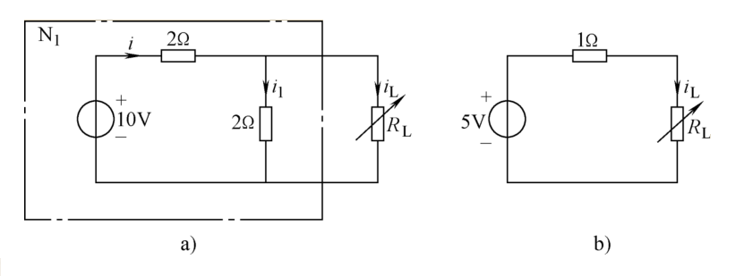
Example：Calculate（1）the resistance of R_{L} for the maximum power,（2）the maximum power,（3）the power transmission efficiency of voltage source 10V.
Calculate the equivalent resistance，and get Thevenin's model（b）.

Slide 60
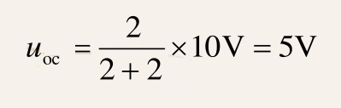
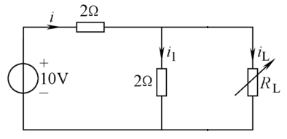
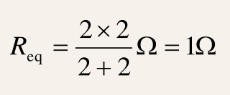

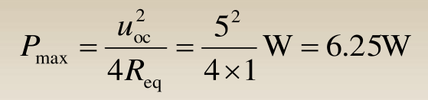
Disconnect the load R_{L} .
Two resistors in series for open circuit voltage：
Two resistors in parallel for Equivalent resistance：
Given ，the maximum power：

Slide 61
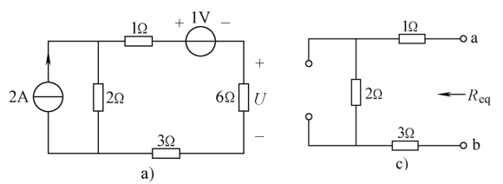
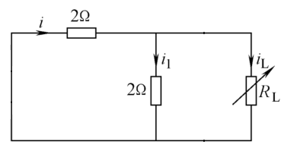
To calculate equivalent resistance:
Voltage source (1V) is short circuited.
Current source (2A) is open circuited.
（Previous example）
Equivalent resistance：
Two resistors in parallel for Equivalent resistance：

Slide 62
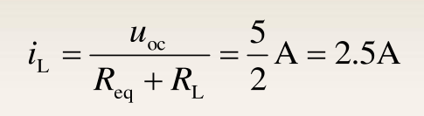

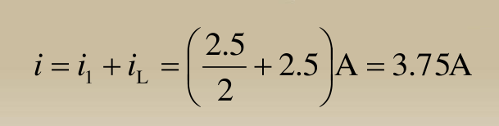
Load current：
Load voltage：
Driven current i：

Slide 63
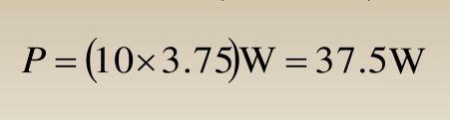
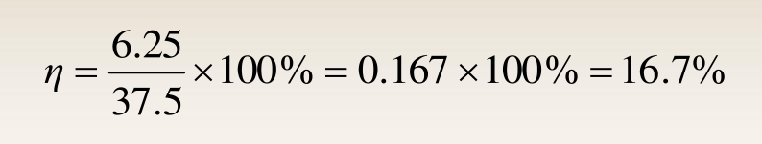
Power of voltage source 10V：
Transmission power：

Slide 64
（8）Why are most power sources the alternating current ？
The alternating current generator has a simple structure, low cost, and high efficiency.
The direct current generator has a more complex structure, high cost, and low efficiency.
The alternating current power can easily increase and decrease the voltage through a transformer.
The direct current voltage boosting is relatively complex, costly, immature in technology, and inefficient.

Slide 65
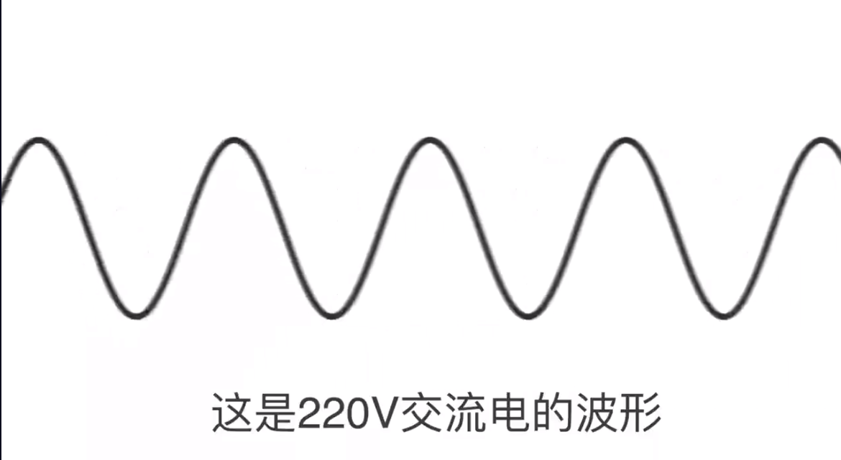



（9）How to convert alternating current into direct current ？
Waveform of alternating current
Only positive cycles can pass
Negative cycles are blocked
Cycles are cut off in half

Slide 66




half-wave rectification
We only get half waves
Use four diodes to get all waves
Rectifier

Slide 67




Current of positive cycles
Half waves
Current of negative cycles
All waves

Slide 68




Full-wave rectifier
All waves
Add the capacitor
Close to direct current

